Slide 1
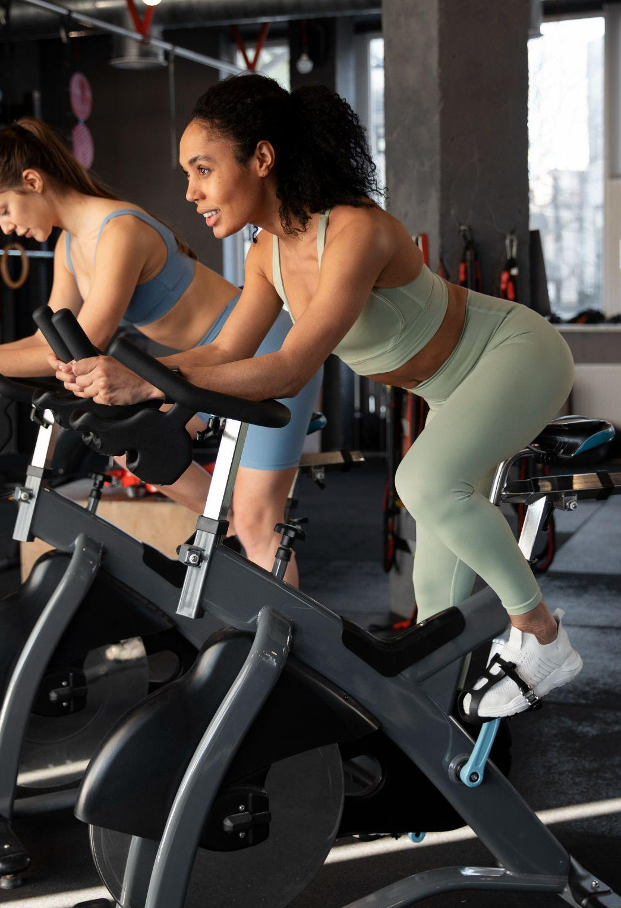

U-FIT Gym Management System
IST 659- Prof. S. Varma
Group Members: Rishabh Rai
Neha Shirodkar

Slide 2
TABLE OF CONTENTS
01
04
02
05
03
06
INTRODUCTION
DEMONSTRATION
DIAGRAMS
AREAS OF IMPROVEMENT
DATASET
CHALLENGES

Slide 3
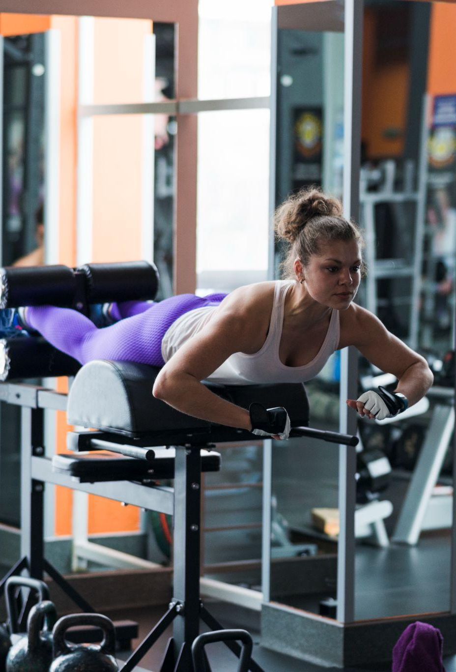
01
INTRODUCTION

Slide 4

About the Project
The gym management system is a software application that helps the members and trainers of the gym to manage their day-to-day operations.
It can be used to manage diets, sessions, equipments, etc.
A gym management system can help gyms improve efficiency, reduce costs, and increase profitability.

Slide 5
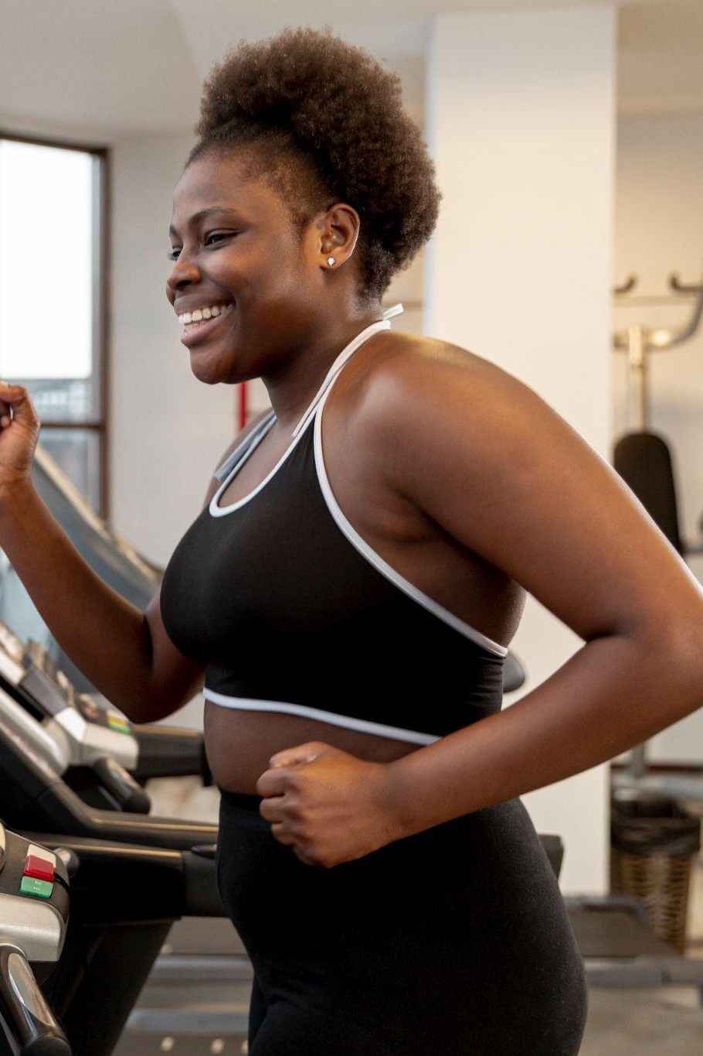
Why this topic?
Because why not!
Personal interest and relevance
Real-world relevance
Diverse data management
User interaction
Data integrity and security
Querying and reporting
System scalability
Learning opportunities
Problem-solving
Project portfolio

Slide 6
02
DIAGRAMS

Slide 7
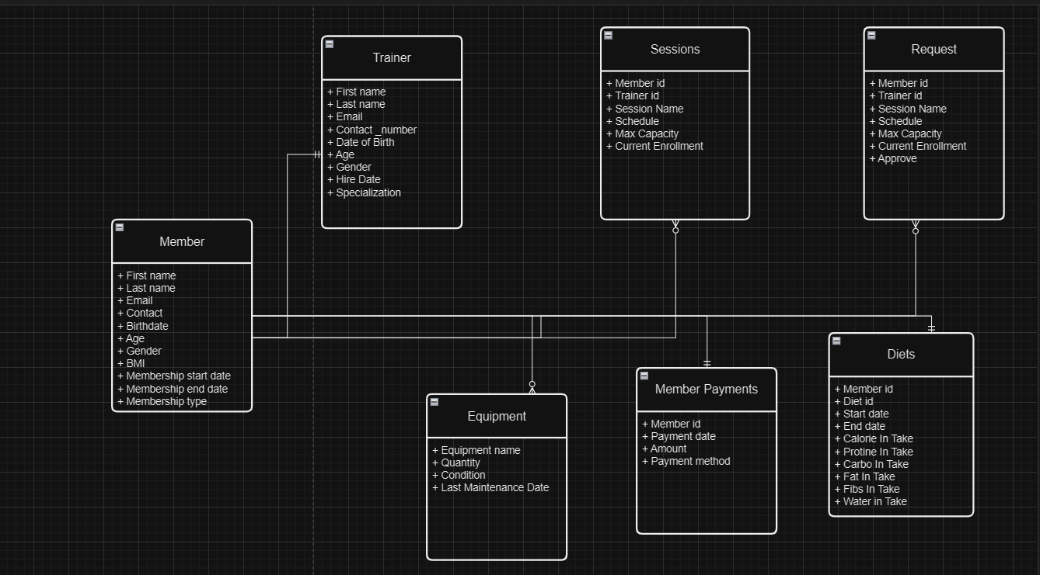
1. Conceptual Data Model

Slide 8
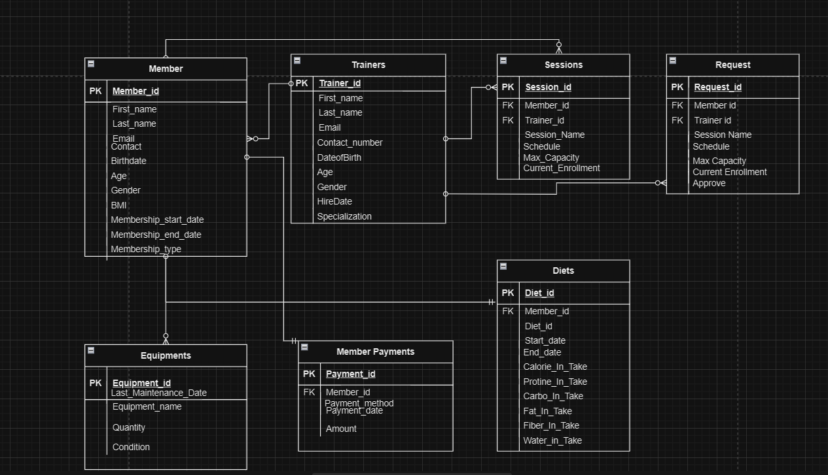
1. Logical Data Model

Slide 9
03
DATASET

Slide 10
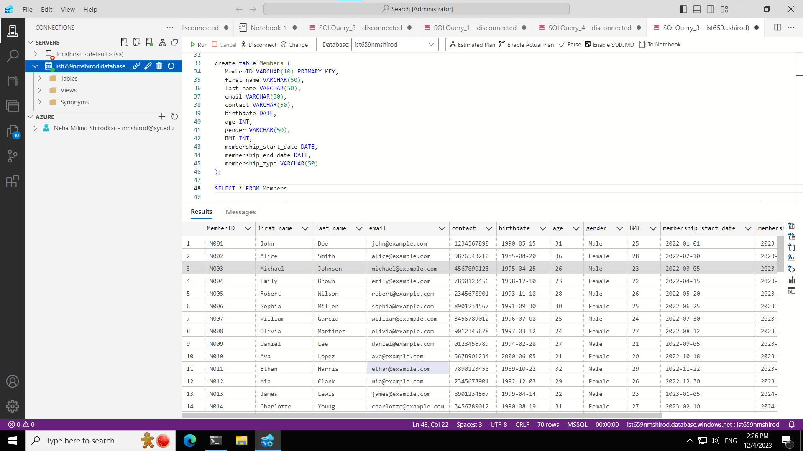
1. Members

Slide 11
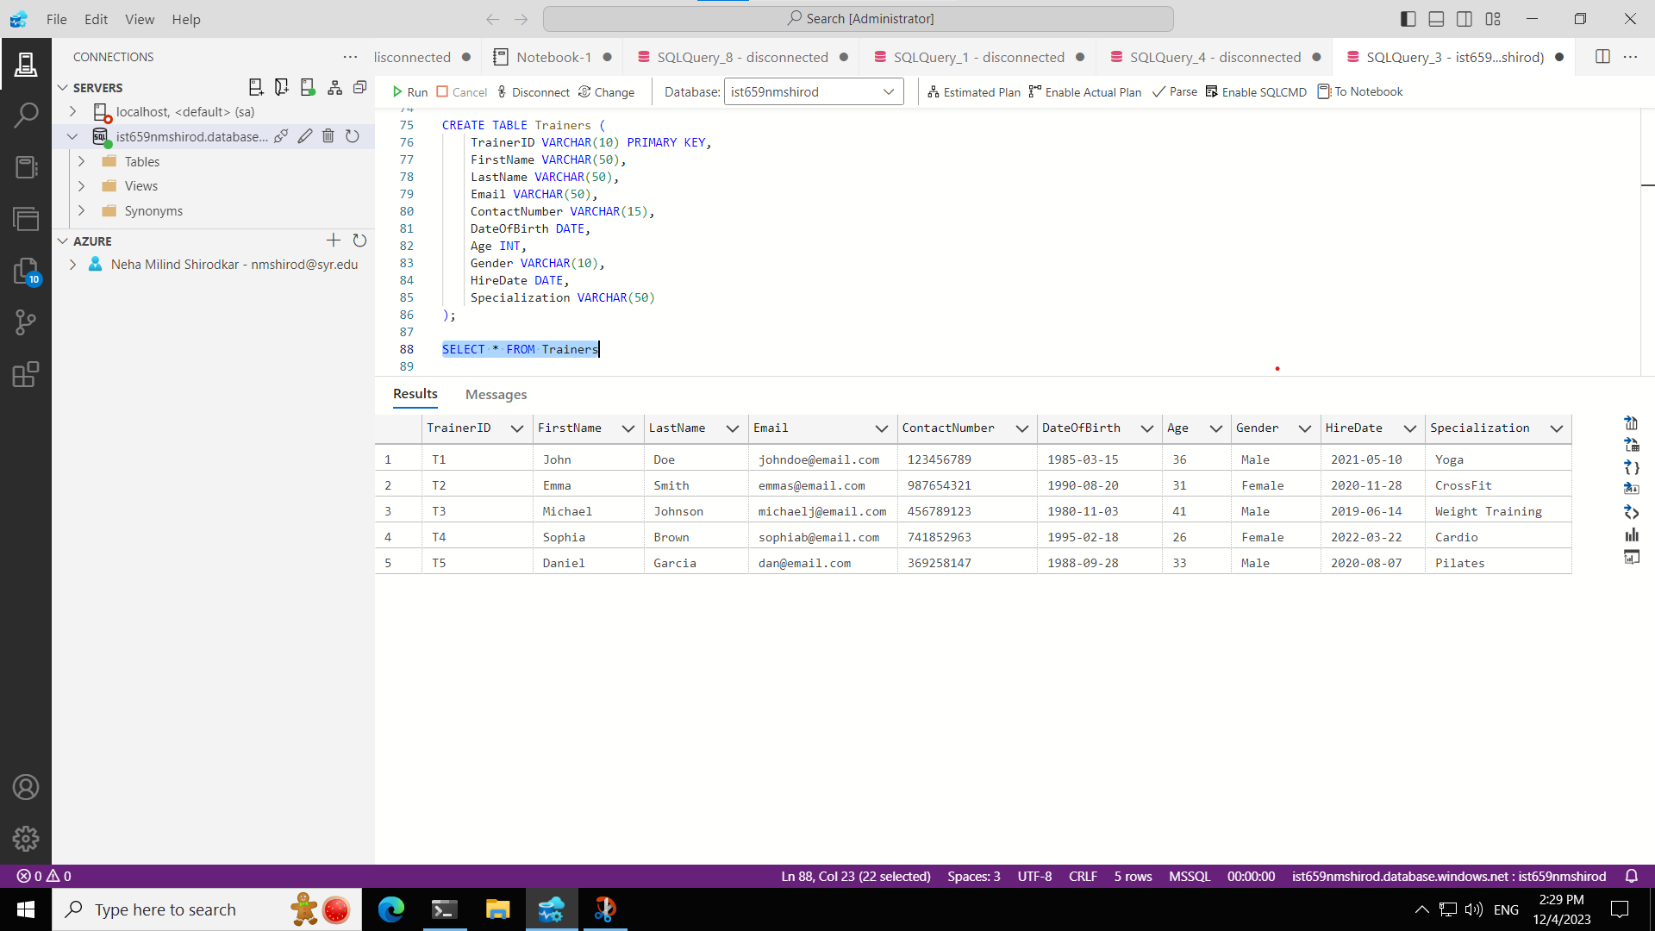
2. Trainers

Slide 12
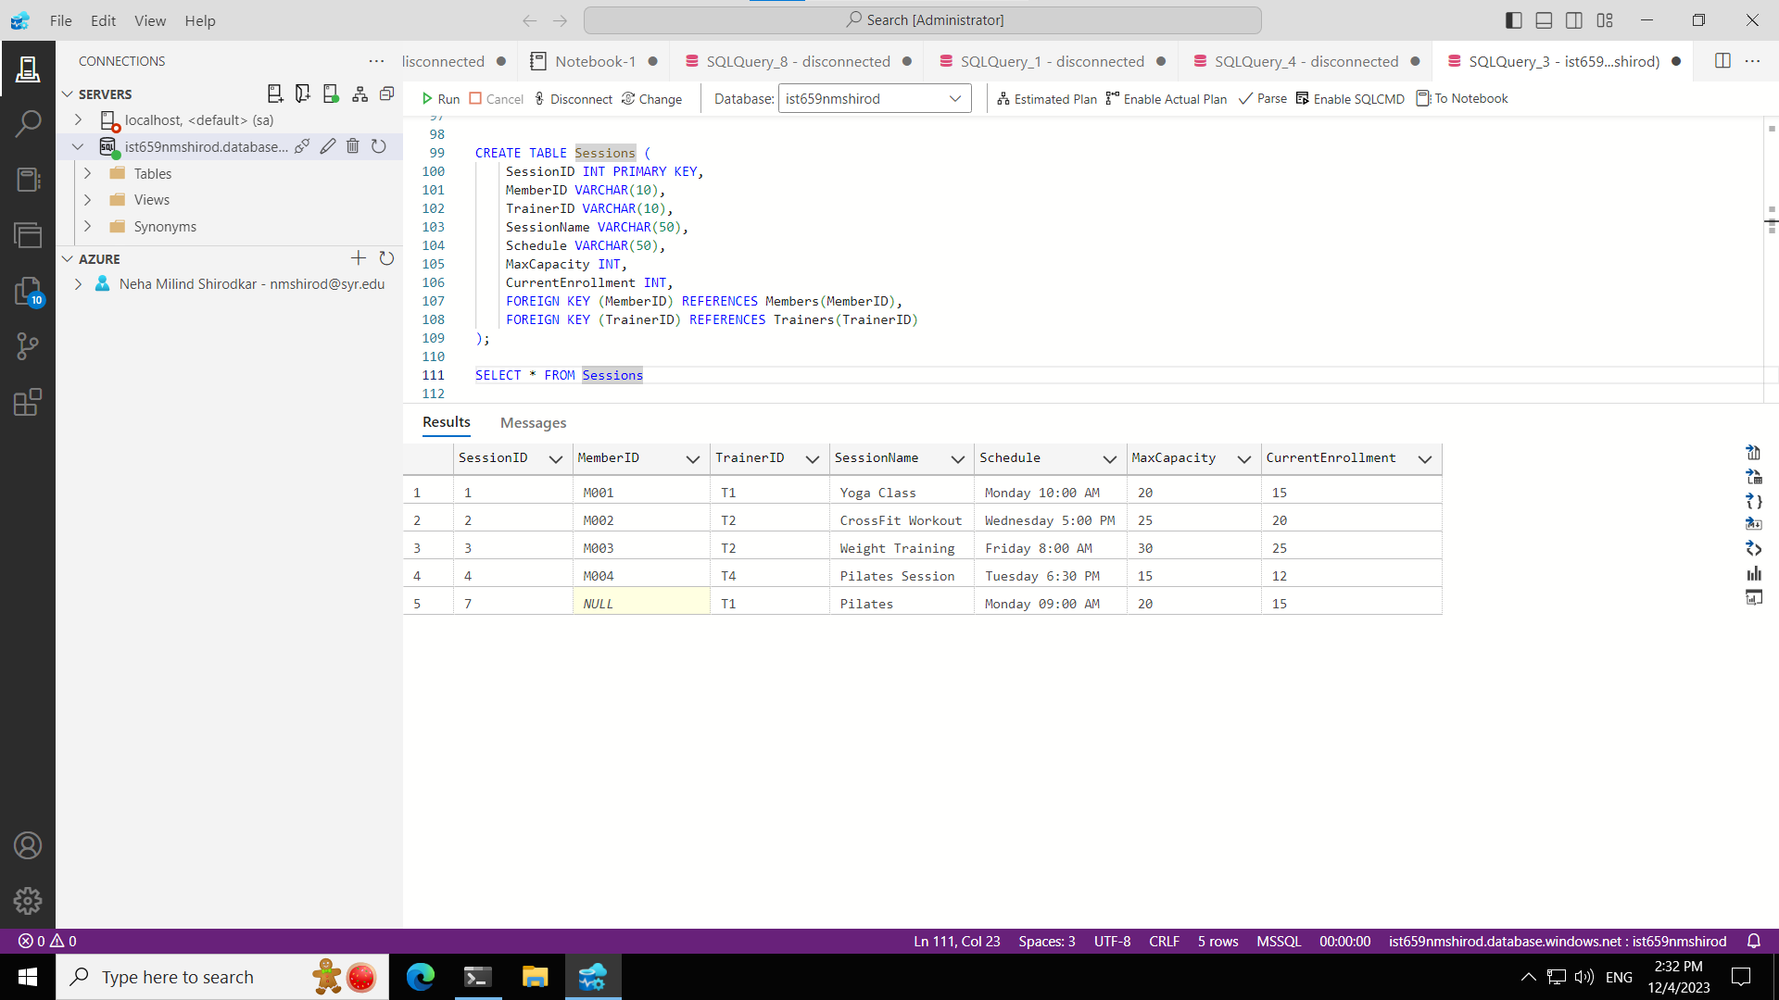
3. Sessions

Slide 13
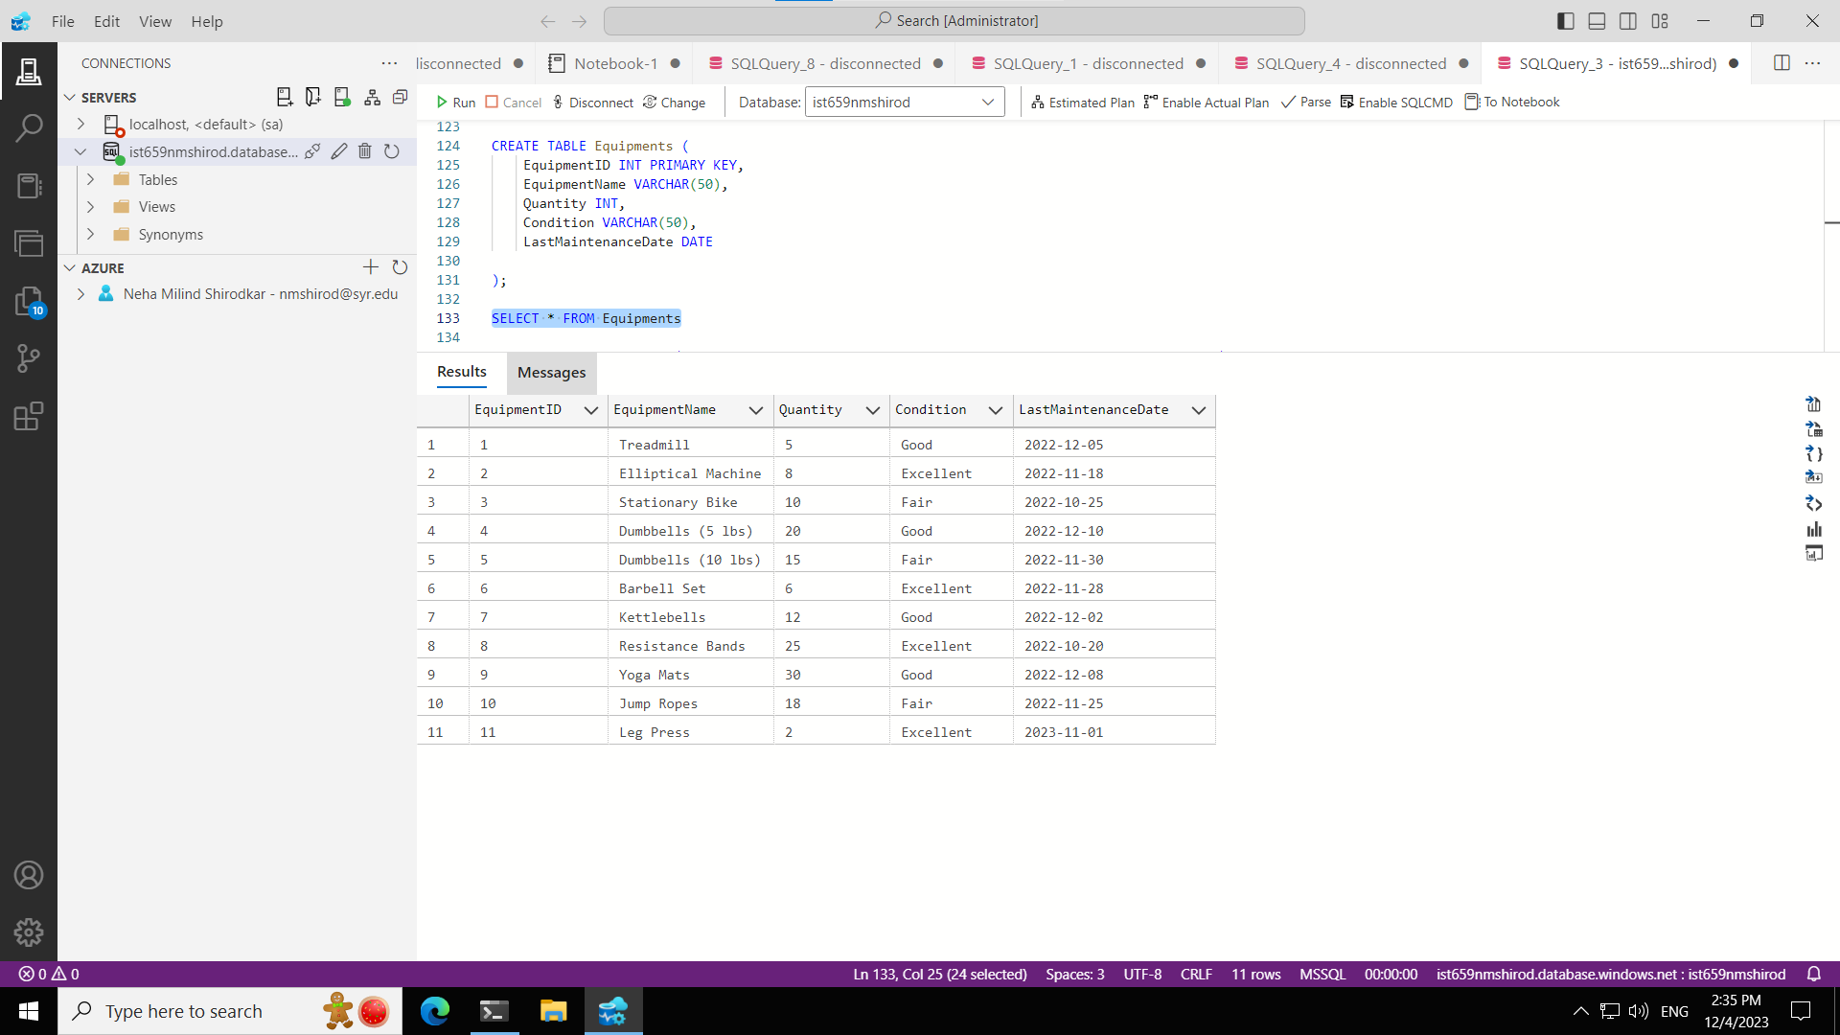
4. Equipments

Slide 14
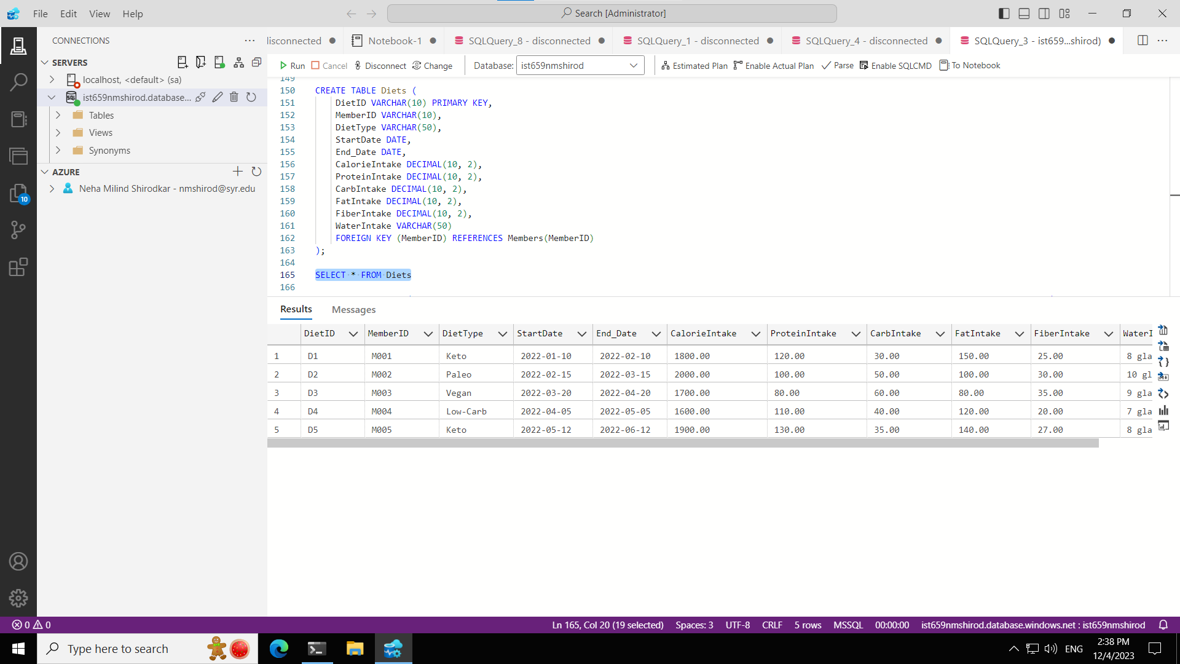
5. Diets

Slide 15
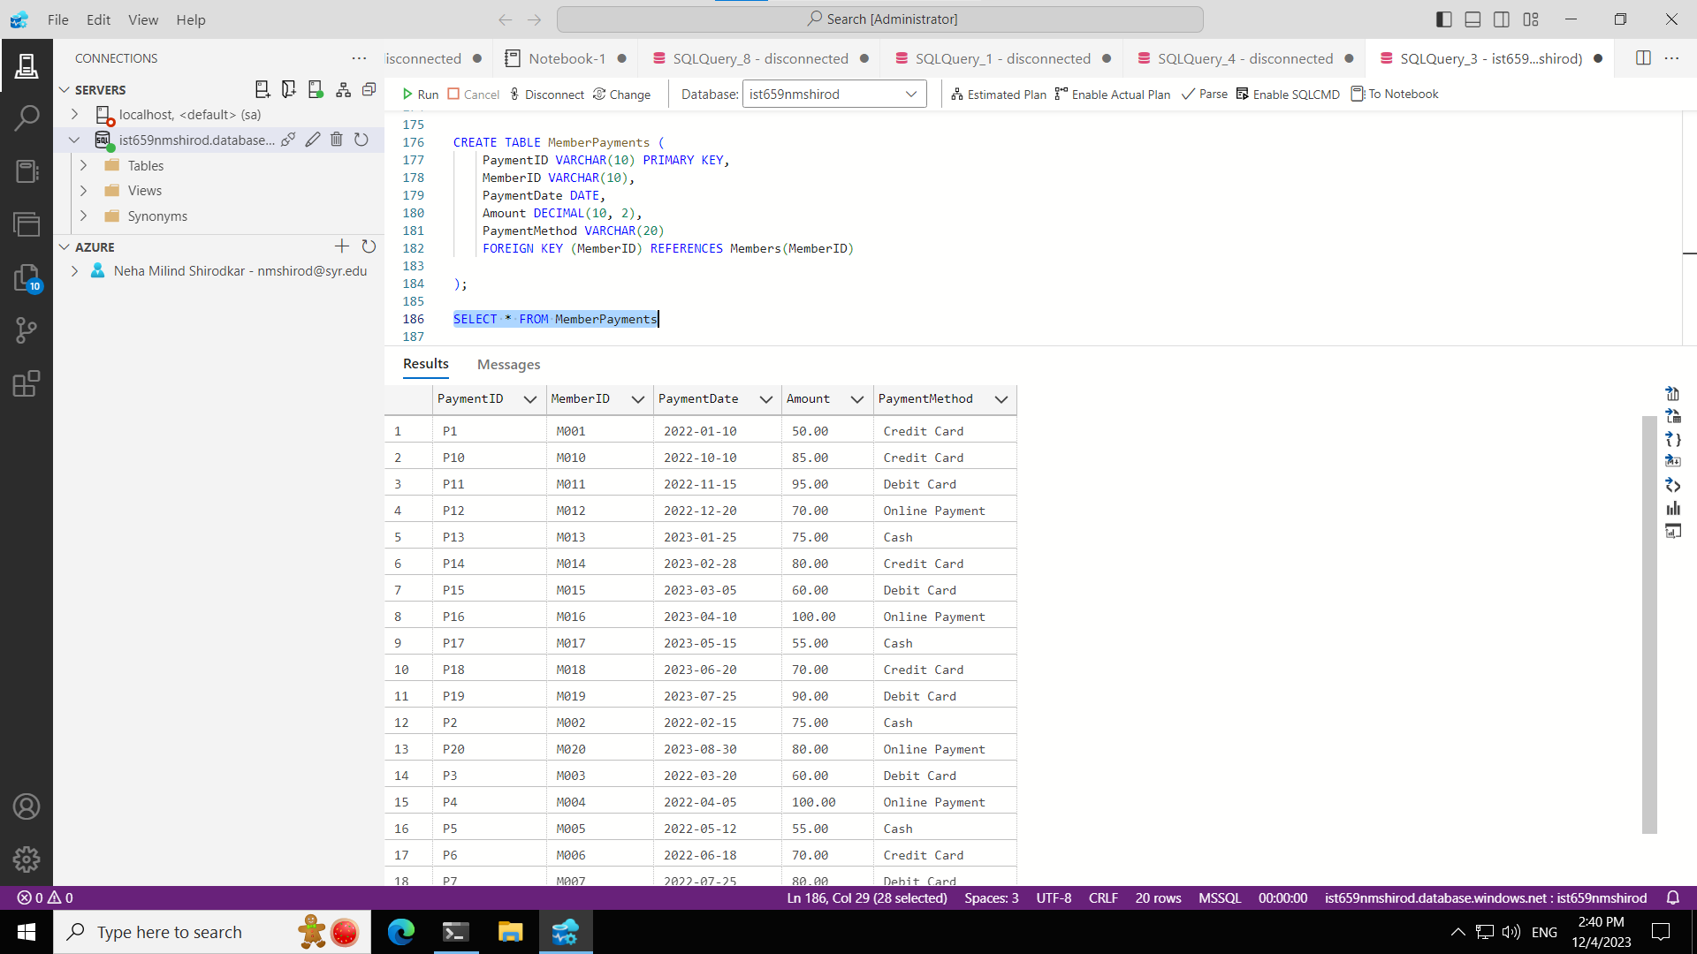
6. Member Payments

Slide 16

7. Requests

Slide 17
04
DEMONSTRATION

Slide 18
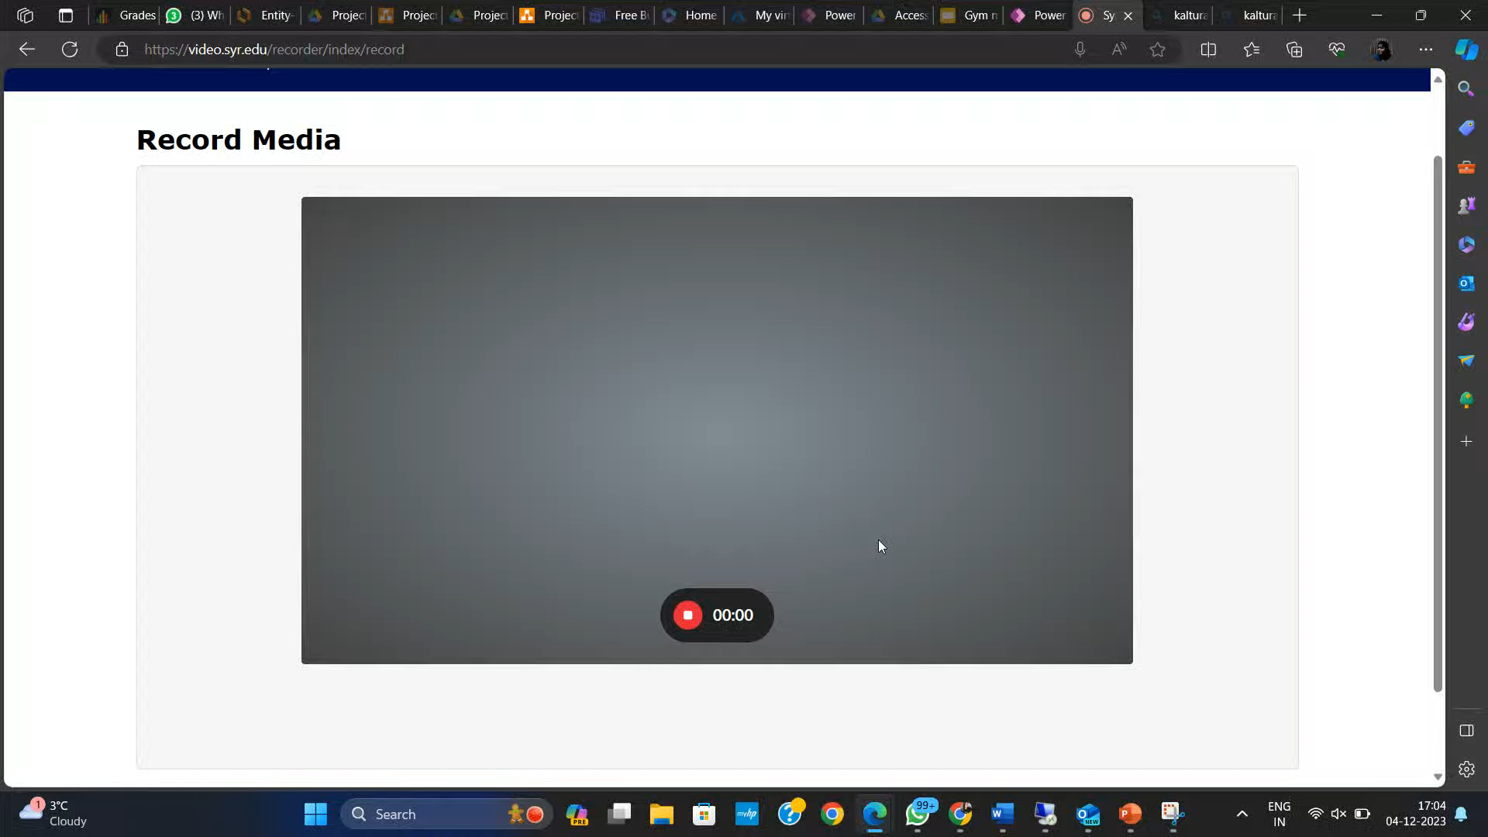
Recorded Video
<iframe src="https://cdnapisec.kaltura.com/p/2707131/sp/270713100/embedIframeJs/uiconf_id/45992501/partner_id/2707131?iframeembed=true&playerId=kplayer&entry_id=1_ymhbwoaz&flashvars[streamerType]=auto" width="640" height="396" allowfullscreen webkitallowfullscreen mozAllowFullScreen allow="autoplay *; fullscreen *; encrypted-media *" frameborder="0"></iframe>

Slide 19
05
AREAS OF IMPROVEMENT

Slide 20
Improvisations: 1. Implement Session and Diet Requests Approval from Trainer. 2. Automated Notifications 3. Payment Interface 4. Personalized Workout Plans 5. Data Analytics and Reporting

Slide 21
06
CHALLENGES

Slide 22
Challenges: 1. Logic building and linking the session and diet request approvals from the Trainer 2. Structuring of the Database 3. Diagram Integration 4. Analytics- Graphs

Slide 23
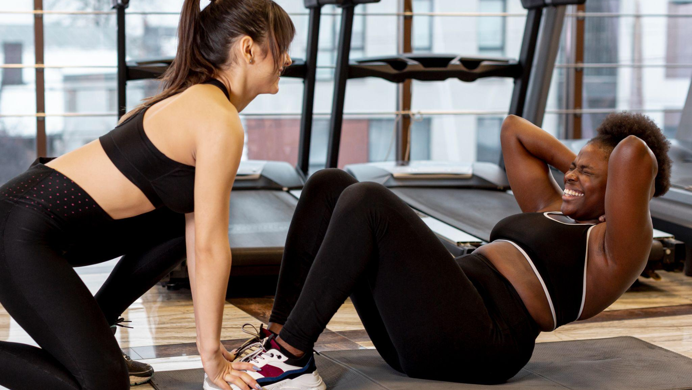
"Strength does not come from what you can do. It comes from overcoming the things you once thought you couldn't"

Slide 24

THANKS!

